Slide 1
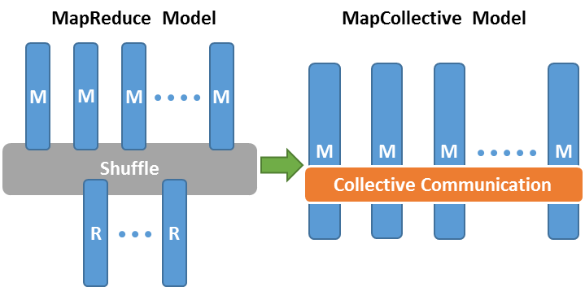
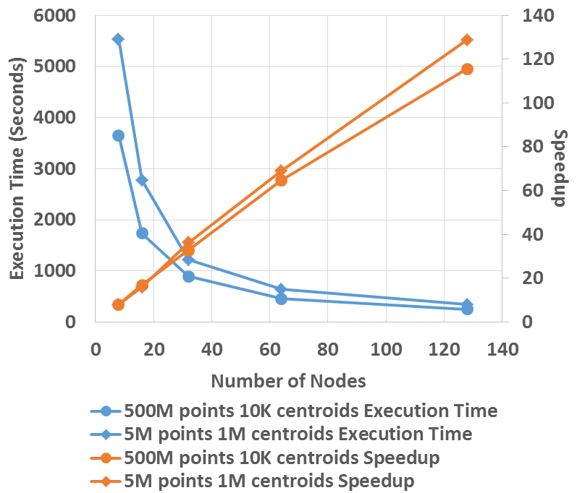
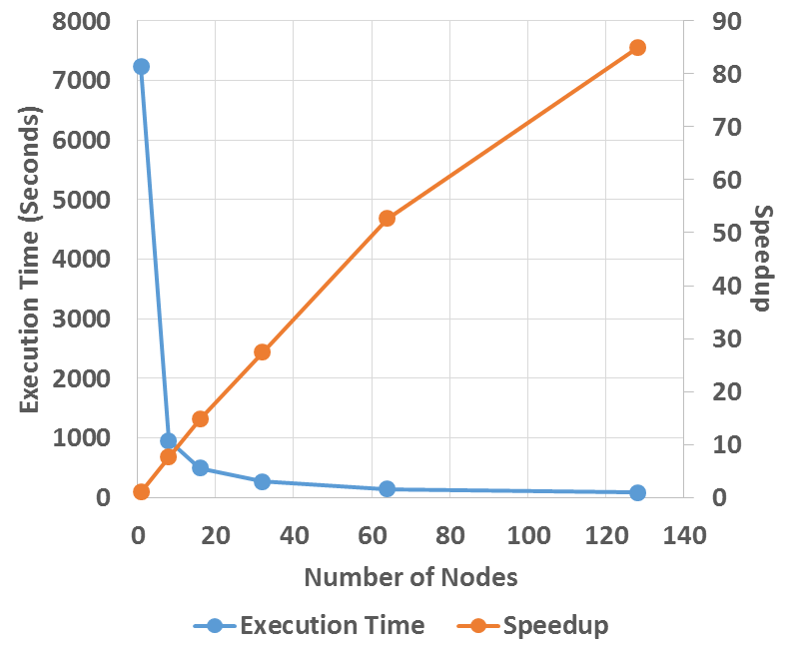


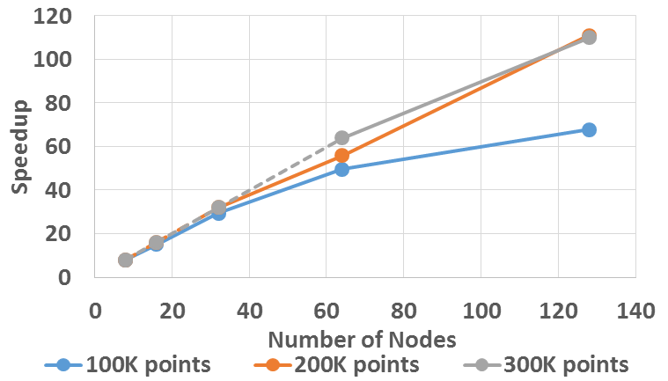
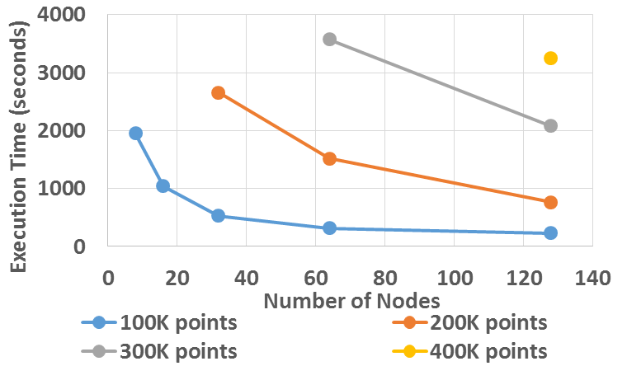

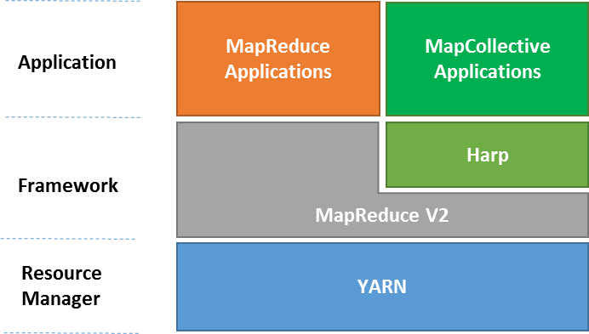
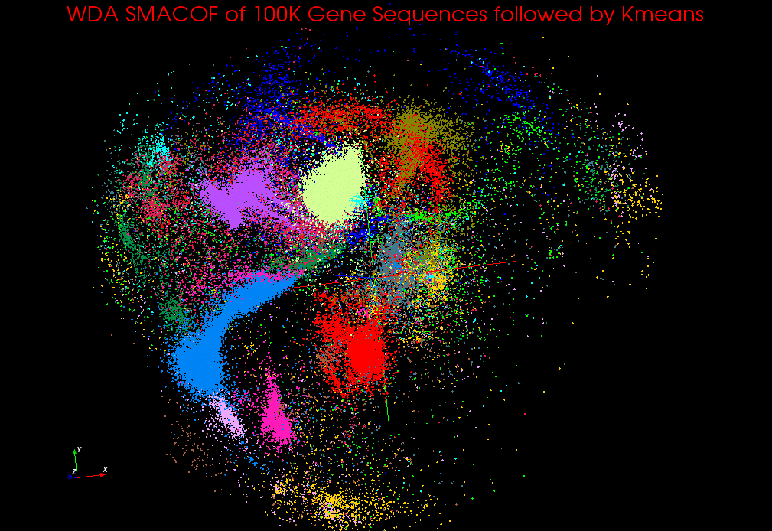
Implementing High Performance Computing with the Apache Big Data Stack: Experience with Harp
Judy Qiu, Bingjing Zhang, Thomas Wiggins
Indiana University
ABSTRACT
EXPERIMENT RESULTS
Harp is the runtime platform for an NSF-funded DIBBs project that we have just started in order to produce many more scalable parallel data analytics capabilities. This will enable the Globus genomics pipeline to offer additional analytics through these new libraries with top performance. We can package our system as services to interface with Globus genomics.
K-means Clustering
Force-directed Graph Drawing Algorithm
M
M
M
M
M
M
M
M
allreduce centroids
allgather positions of vertices
The Harp plugin is currently supported by Hadoop 1.2.1 and Hadoop 2.2.0. Harp architecture is an extension on next generation MapReduce frameworks with Yarn resource manager, providing support to MapCollective applications (see figures).
WDA-SMACOF
M
M
M
M
allgather and allreduce results in the conjugate gradient process
HIGH PERFORMACE DATA ANALYTICS
allreduce the stress value
Iterative computation is a kernel function to many data mining and data analysis algorithms. Missing in current MapReduce frameworks is collective communication, which is an essential element in many iterative algorithms. We introduce the “Harp library” to improve the expressiveness and high performance in Big Data processing. This library provides a common set of data abstractions and related collective communication abstractions to transform Map-Reduce programming models into Map-Collective models, thereby addressing large collectives which are a distinctive feature of data intensive and data mining applications.
Harp is an open source project from Indiana University that builds on our earlier work, Twister and Twister4Azure. We implemented Harp as a library that plugs into Hadoop and enables users to run complex data analysis and machine learning algorithms on both clouds and supercomputers.
We built Map-Collective as a unified model to improve the performance and expressiveness of big data tools. We run Harp on K-means, Graph Layout, and Multidimensional Scaling algorithms with realistic application datasets over 4096 cores on the IU BigRed II Supercomputer (Cray/Gemini) where we have achieved linear speedup.
The Scaling by Majorizing a Complicated Function (SMACOF) MDS algorithm is known to be fast and efficient. DA-SMACOF can reduce the time cost and find global optima by using deterministic annealing. The drawback is it assumes all weights are equal to one for all input distance matrices. To remedy this we added a weighting function to the SMACOF function, called WDA-SMACOF.
BACKGROUND
With the increase in both volume and complexity of data nowadays, a runtime environment needs to integrate with community infrastructure which supports interoperable, sustainable and high performance data analytics. One solution is to converge Apache Big Data stack with a High Performance Cyberinfrastructure (HPC-ABDS) into well-defined and implemented common building blocks, providing richness in capabilities and productivity. HPC-ABDS aims to provide them in a library form, so that they can be reused by higher-level applications and tuned for specific domain problems like Machine Learning.
CONCLUSIONS
REFERENCES
Harp demonstrates the portability of HPC-ABDS to HPC and eventually Exascale systems. With this plug-in, Map-Reduce jobs can be transformed into Map-Collective jobs. For the first time, Map-Collective brings high performance to the Apache Big Data Stack in a clear communication abstraction, which did not exist before in the Hadoop ecosystem. We expect Harp to equal MPI performance with straightforward optimizations.
[1] J. Qiu, S. Jha, A. Luckow, G. Fox, Towards HPC-ABDS: An Initial High-Performance Big Data Stack, accepted to the proceedings of ACM 1st Big Data Interoperability Framework Workshop: Building Robust Big Data ecosystem, NIST special publication, March 13-21, 2014.
[2] B. Zhang, Y. Ruan, J. Qiu. Harp: Collective Communication on Hadoop, Proceedings of IEEE International Conference on Cloud Engineering (IC2E 2015)

